Slide 1

Python for Data Science
19CSE432: Lecture 3
B. Tech. 2021
Course Leader:
Dr. Yatish Bathla
yatishbathla@outlook.com
Dr. Mohan Kumar
mohan.cs.et@msruas.ac.in

Slide 2
Lecture Objectives
At the end of this lecture, student will be able to understand
Review of syntax and core constructs
Namespace and Variable Scope
Overview of Python for Data Science and its Advantages
Standard Libraries for Python in Data Science

Slide 3
Topics
Syntax and Core constructs
Namespace and Variable Scope
Python for Data Science
Standard Libraries

Slide 4
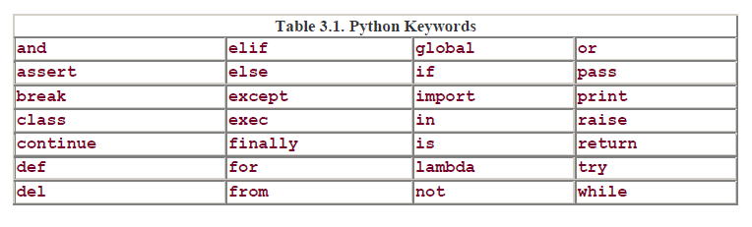
Syntax and Core constructs
Keywords
Python currently has twenty-eight keywords.

Slide 5
Syntax and Core constructs
Built-ins
Python has a set of "built-in„ names which are used by the interpreter that are available at any level of Python code.
"reserved for the system" and not used for any other purpose.
Underscore: It is usage in Python system, interpreter, and built-in identifiers; therefore, programmer avoid the use of beginning variable names with the underscore.

Slide 6
Syntax and Core constructs
Variable Declarations: In Python, there are no explicit variable declarations. Variables are "declared" on first assignment.
Memory Allocation: not only do we not have to explicitly allocate the memory, but we also don't have to deallocate it either
Garbage Collection: Python's garbage collector will automatically deallocate a data object once is it no longer needed, all without requiring any management on the programmer's part

Slide 7
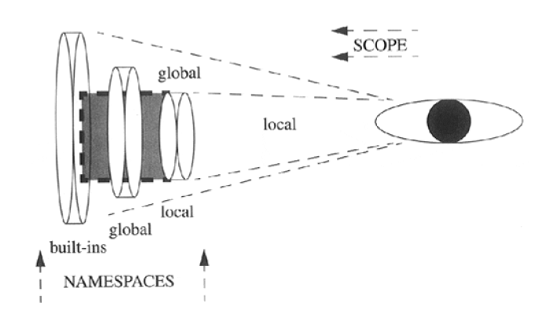
Variable Scope & Namespaces
Variable Scope: refer to as "variable visibility. Variables either have local or global scope.
Namespaces: From within a function, the local scope encompasses the local namespace, the first place a name is searched for. From the global scope (outside of any function), a name lookup begins with the global namespace. If no match is found, the search proceeds to the built-in namespace.

Slide 8
Python for Data Science
Advantage
Most popular dynamic, programming languages, along with Perl, Ruby, and others.
Python is distinguished by its large and active scientific computing community.
For data analysis and interactive, exploratory computing and data visualization, Python being compared with R, MATLAB, SAS, Stata, and others.
Python’s improved library support (primarily pandas) has made it a strong alternative for data manipulation tasks.
Excellent choice as a single language for building data-centric applications.
Ease of integrating C, C++, and FORTRAN code
Python is a suitable language not only for doing research and prototyping but also building the production systems

Slide 9
Python for Data Science
Disadvantage
Python code will run substantially slower than code written in a compiled language like Java or C++.
Not an ideal language for highly concurrent, multithreaded applications, particularly applications with many CPU-bound threads.

Slide 10
Standard Libraries of Python in Data Science
NumPy
Foundational package for scientific computing in Python.
A fast and efficient multidimensional array object ndarray
Functions for performing element-wise computations with arrays or mathematical operations between arrays
Tools for reading and writing array-based data sets to disk
Linear algebra operations, Fourier transform, and random number generation
Tools for integrating connecting C, C++, and Fortran code to Python
For numerical data, NumPy arrays are a much more efficient way of storing and manipulating data

Slide 11
Standard Libraries of Python in Data Science
pandas
structured data fast, easy, and expressive.
powerful and productive data analysis environment.
primary object in pandas is the DataFrame, a two dimensional tabular, column-oriented data structure with both row and column labels
It provides sophisticated indexing functionality to make it easy to reshape, slice and dice, perform aggregations, and select subsets of data.
ideal tool for financial data analysis applications, statistical computing
Matplotlib
most popular Python library for producing plots and other 2D data
It integrates well with IPython (see below), thus providing a comfortable interactive environment for plotting and exploring data.

Slide 12
Standard Libraries of Python in Data Science
IPython
a robust and productive environment for interactive and exploratory computing.
enhanced Python shell designed to accelerate the writing, testing, and debugging of Python code.
SciPy
collection of packages addressing a number of different standard problem domains in scientific computing.
together NumPy and SciPy form a reasonably complete computational replacement for much of MATLAB along with some of its add-on toolboxes.

Slide 13
Summary
Basic concepts of syntax and core constructs: Keywords, Built-Ins, Variable Declarations, Memory allocation, Garbage collection
Namespace and Variable scope and difference between the two
Overview methodology of Python for Data Science, its Advantage and Disadvantage
Standard Libraries of Python in Data Science: NumPy, pandas, Matplotlib, IPython & SciPy

